Slide 1
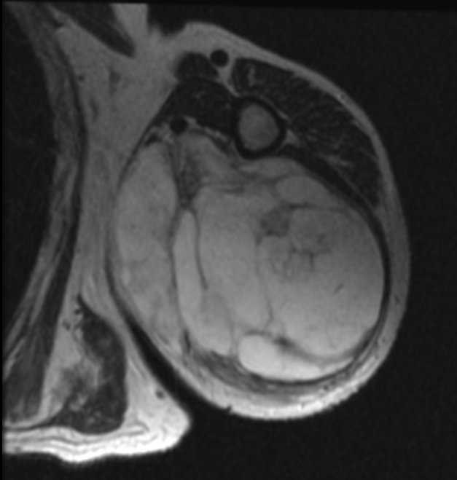
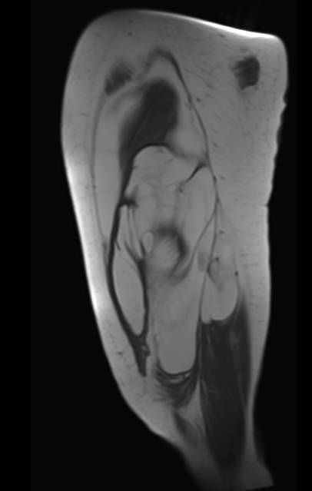
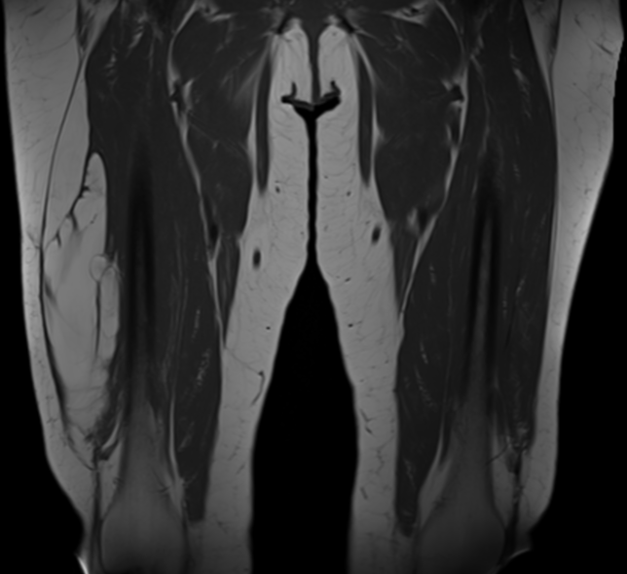
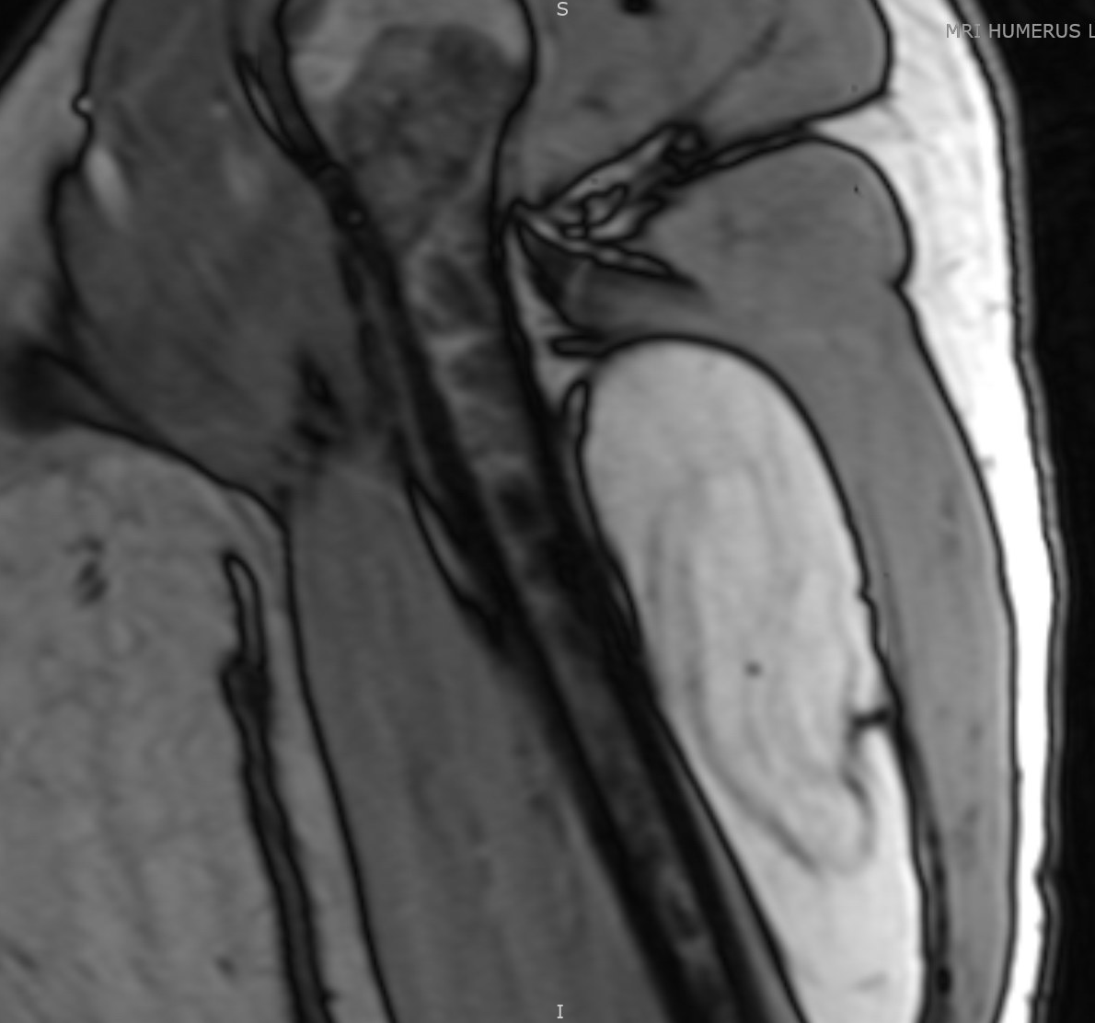
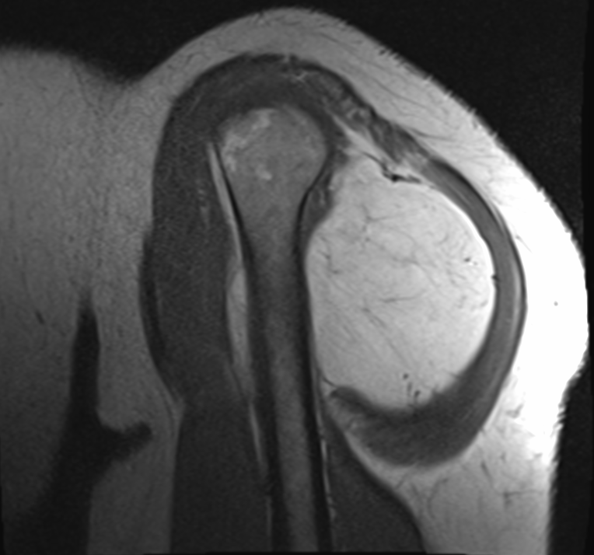
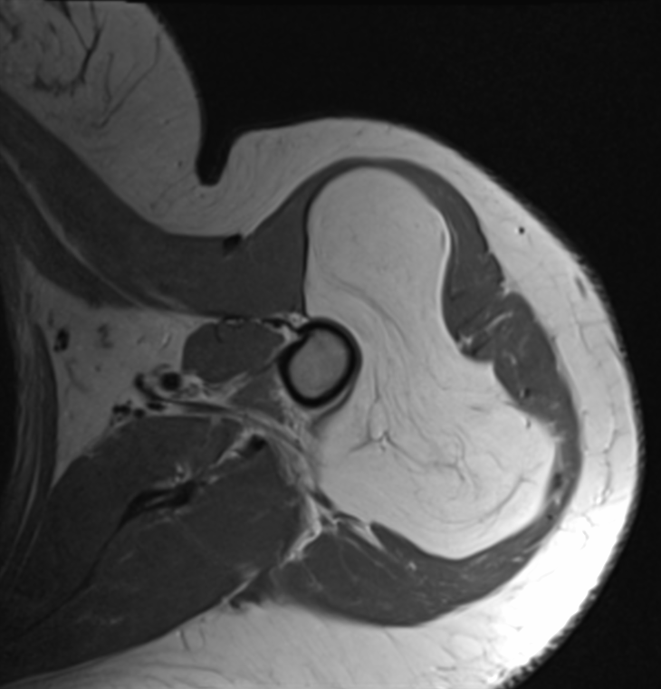
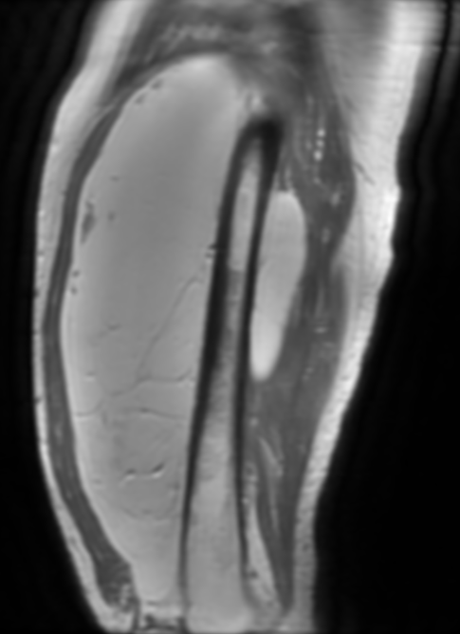
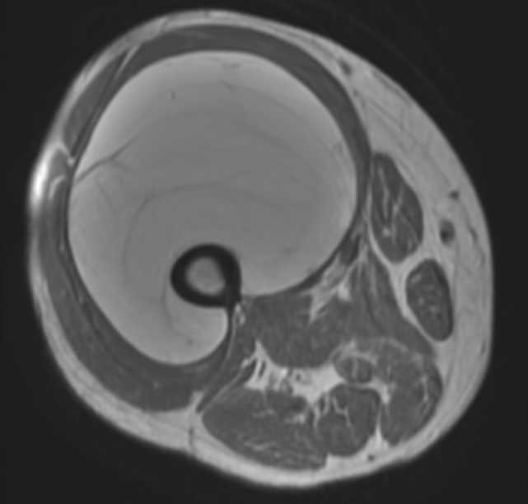
Radiological Differences Between
Lipoma and Low-Grade Liposarcoma
Laura Sonnylal, B.S.¹, Tyler Hoskins, B.S.¹, James C. Wittig, M.D.¹
¹John Theurer Cancer Center, Hackensack University Medical Center
Background
Lipomas, benign tumors composed entirely of mature adipose tissue, are the most common types of soft tissue tumors. The malignant type of fatty tumors, liposarcoma, is the second most common type of soft tissue tumor in adults. Misdiagnoses of lipomas vs low grade liposarcomas are relatively common due to apparent similarities between MRI images. Low grade liposarcomas may dedifferentiate and then metastasize. Detailed scrutiny of MRI scans may help differentiate lipomas from low grade liposarcomas. Stranding, nodularity, size, margin of mass, and homogeneity of contents are potential indicators of a low grade liposarcoma as opposed to a lipoma.
Purpose
5A
5B
The purpose of this study is to retrospectively review radiological studies, specifically MR, of patients diagnosed with lipomatous masses in an effort to differentiate between lipomas and low grade liposarcomas. In addition, this study aims to educate future patients and physicians about diagnosis, treatment, and management, as well as benefits.
Figure 5. MRI T1 sagittal (A) and coronal (B) view of low grade liposarcoma right lower extremity
Figure 2. MRI T1 axial view of a low grade liposarcoma left upper extremity
Results
Patients & Methods
There were 13 patients definitively diagnosed pathologically with a low grade liposarcoma (17%), while 65 patients were diagnosed with a lipoma (83%). The average size of a lipoma was 6.3cm (3-10). The average size of a low grade liposarcoma was 20.5cm (11-47). The presence of thick septae was found in 38% of low grade liposarcoma patients. MRI of low grade liposarcomas showed a multilobular mass in 75% of cases, while lipomas showed a single lobular mass in 88% of cases. Internal heterogeneity was seen in 16% of low grade liposarcoma cases. Three patients (5%) who were diagnosed to have a lipoma according to the preop MRI were actually low grade liposarcomas histologically. Radiographic images showed features congruent with a large lipoma, such as an average size of 10.5 cm (9-12), thin septations, and extensive fatty proliferation. All patients who were thought to have a low gradeliposarcoma according to the preoperativer MRI proved to be low grade liposarcomas histologically.
This study retrospectively reviewed 78 patients, from November 2013 to February 2017, treated for a lipomatous mass. Age ranged from 28-83 (avg: 68 years). There were 42% females and 58% males. We reviewed all initial radiological diagnoses prior to orthopedic oncologic evaluation. The charts were separated by a final diagnosis of either lipoma or low grade liposarcoma. Comparison between radiologic impressions and final clinical diagnoses was made to determine accuracy. Radiological features of size, nodularity, and homogeneity were noted to determine a proper correlation between the MRI and tumor type.
Figure 3. MRI T1 sagittal view of a low grade liposarcoma left upper extremity
Conclusions
The most indicative step to definitively differentiate low grade liposarcomas from lipomas is to focus on specific radiologic details such a size, nodularity, stranding, lobularity and heterogeneity. In general, low grade liposarcomas are larger than 10 cm, multilobular, and heterogeneous in nature. They usually demonstrate significant internal stranding and nodularity. There are a small percentage of low grade liposarcomas that do not demonstrate these characteristics and may be interpreted as a large lipoma based on MRI. While both low grade liposarcomas and benign lipomas may recur following removal, low grade liposarcomas have the potential to dedifferentiate and become more aggressive. One can not be entirely sure based on MRI alone that a large deep mass is purely a lipoma providing an argument in favor of excision when identified.
1A
1B
4A
4B
Figure 1. MRI sagittal (A) and axial (B) view of well encapsulated lipoma left shoulder measuring 10x5x10cm located deep to the deltoid.
Figure 4. MRI T1 sagittal (A) and axial view of a low grade liposarcoma right femur
Contact
References
James C. Wittig, M.D.
Hackensack University Medical Center
20 Prospect Avenue, Suite 501
Hackensack, NJ 07601
Email: DrJamesWittig@gmail.com
Phone: (551) 996-2533
Keiji M, Sinsuke H, Michihito I, Tokuhiro C, Hidetoshi O. MRI Findings in intramuscular lipomas. Skeletal Radiology. (1999) 28:145-152
Jones A.P, Lewis C.J, Dildey P, et al. Lipoma or liposarcoma? A cautionary case report. Journal of Plastic, Reconstructive & Aesthetic Surgery (Jan 2012) 65: e11-e14

